Slide 1
Implementing Domain Driven Design (DDD)
a practical guide

Slide 2
Overview
Part-I: What is DDD? Why and where we should use it?
Part-II: DDD
Architecture & Layers
Execution Flow
Building Blocks
Common Rules
Part-III: Implementation
Layering a Visual Studio Solution
Building Blocks: Key rules & samples

Slide 3
Part-I: What is DDD?
Why and where we should use it?

Slide 4
TODO..!

Slide 5
Part-III: DDD
DDD Architecture & Building Blocks

Slide 6
Domain Driven Design Layers
TODO

Slide 7

Domain Driven Design Execution Flow
PRESENTATION layer
APPLICATION layer
DOMAIN layer
HTTP request
Entities
Browsers
MVC UI
DTO
html/js/css
Application
Services
Domain Services
HTTP request
Remote clients
HTTP API
DTO
Repositories (interface)
JSON
Distributed Services
Layer
Exception Handling
Audit Logging
Caching
Authorization
Validation
Authorization
Validation
Unit of Work / DB Transaction
C r o s s C u t t i n g C o n c e r n s

Slide 8
Part-III: Implementation
Implementing Domain Driven Design (DDD)

Slide 9
Aggregate Roots Principles
Should maintain self integrity & validity
Implements domain rules
Saved & retrieved as a single unit (with sub-collections)

Slide 10
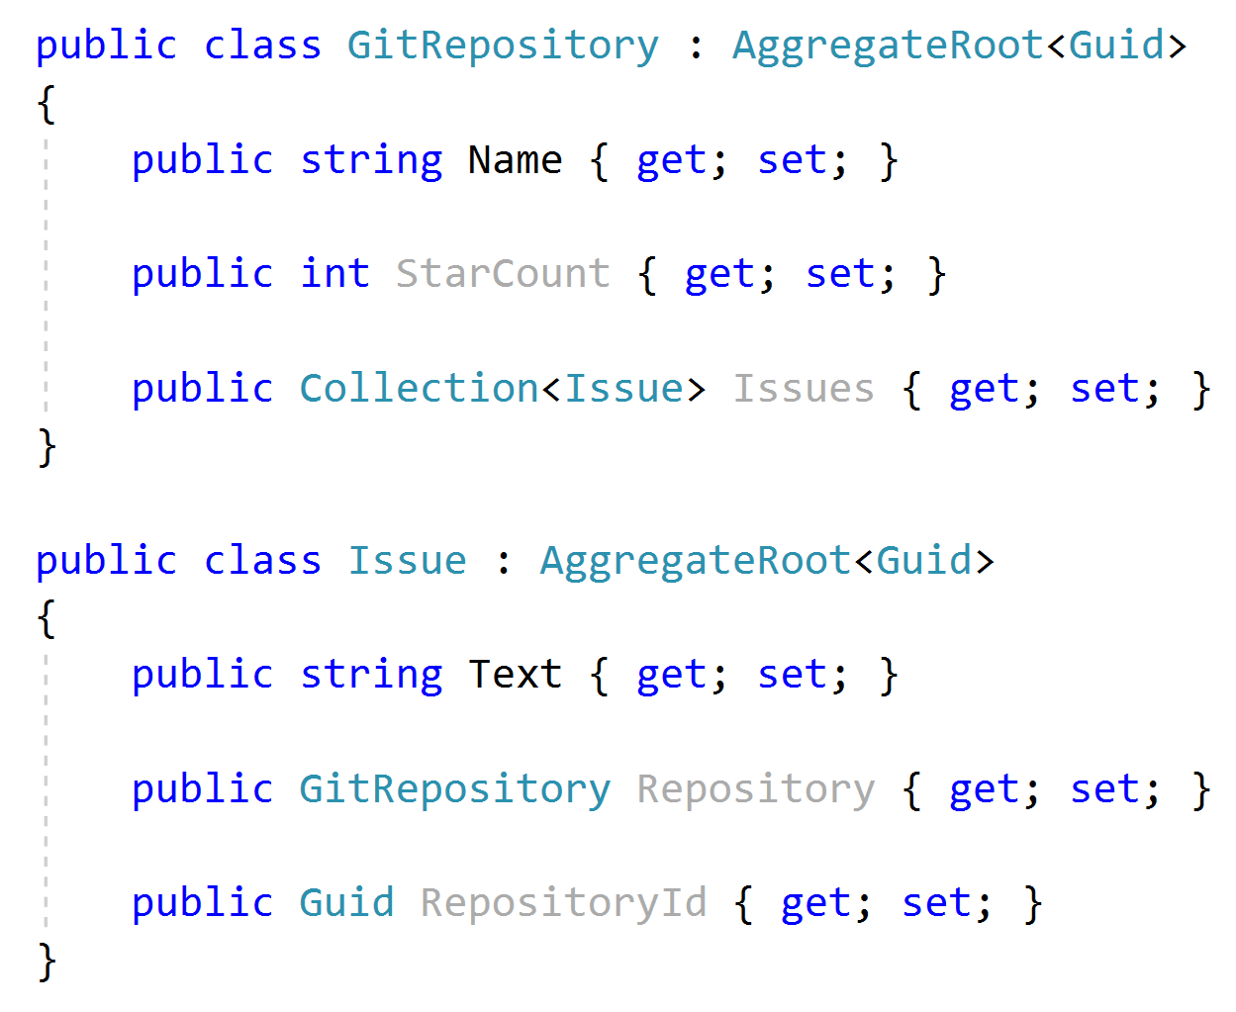


Aggregate Roots Rule: Reference other aggregates by Id

Slide 11
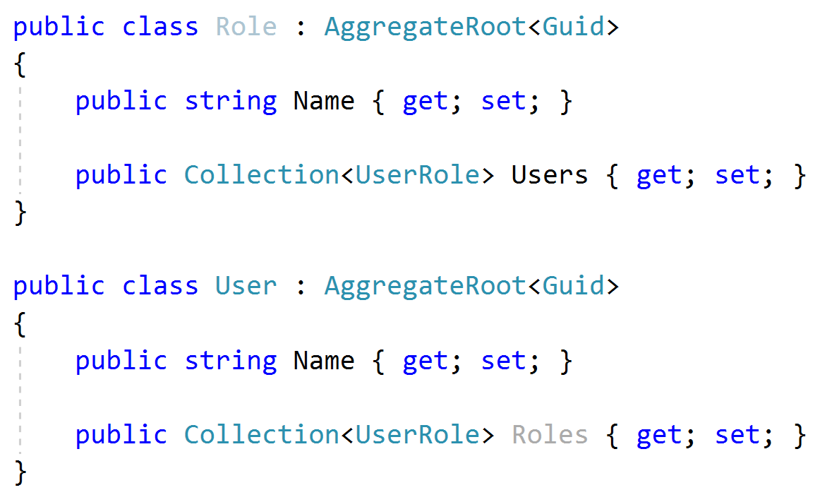
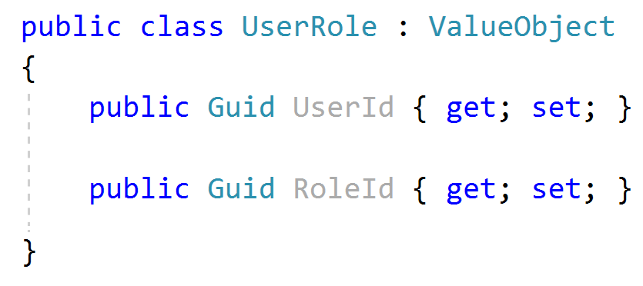
Aggregate Roots Tip: Keep it small
Considerations;
Query Performance
Data Integrity & Validity
Should be serializable (required for NoSQL databases)

Slide 12
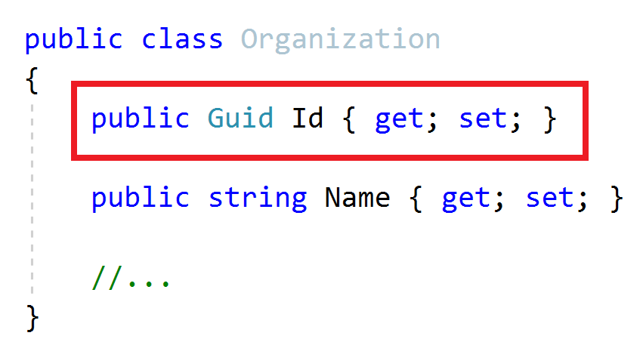
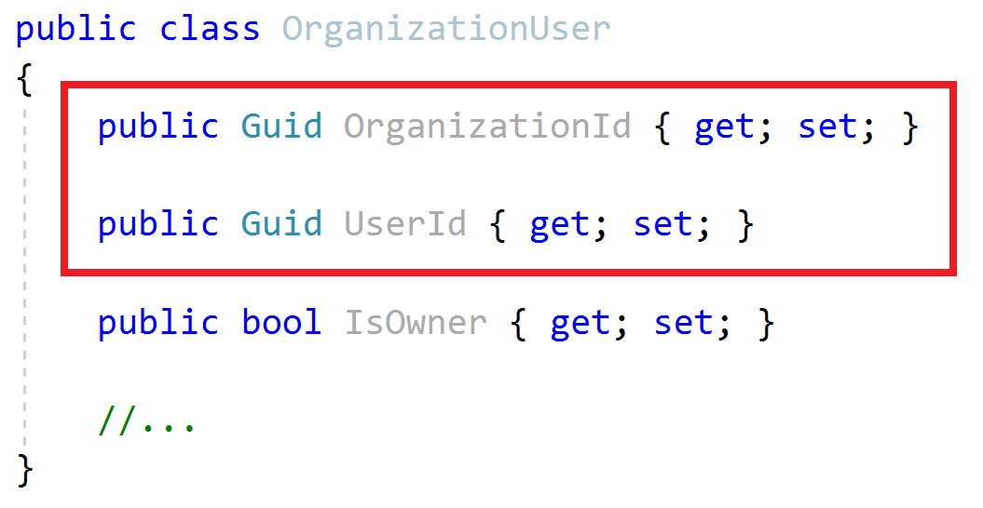
Aggregate Roots / Entities Primary Keys
Aggregate Root
Entity
Define a single Primary Key (Id)
Define a composite Primary Key
Suggestion: Prefer GUID as the PK

Slide 13
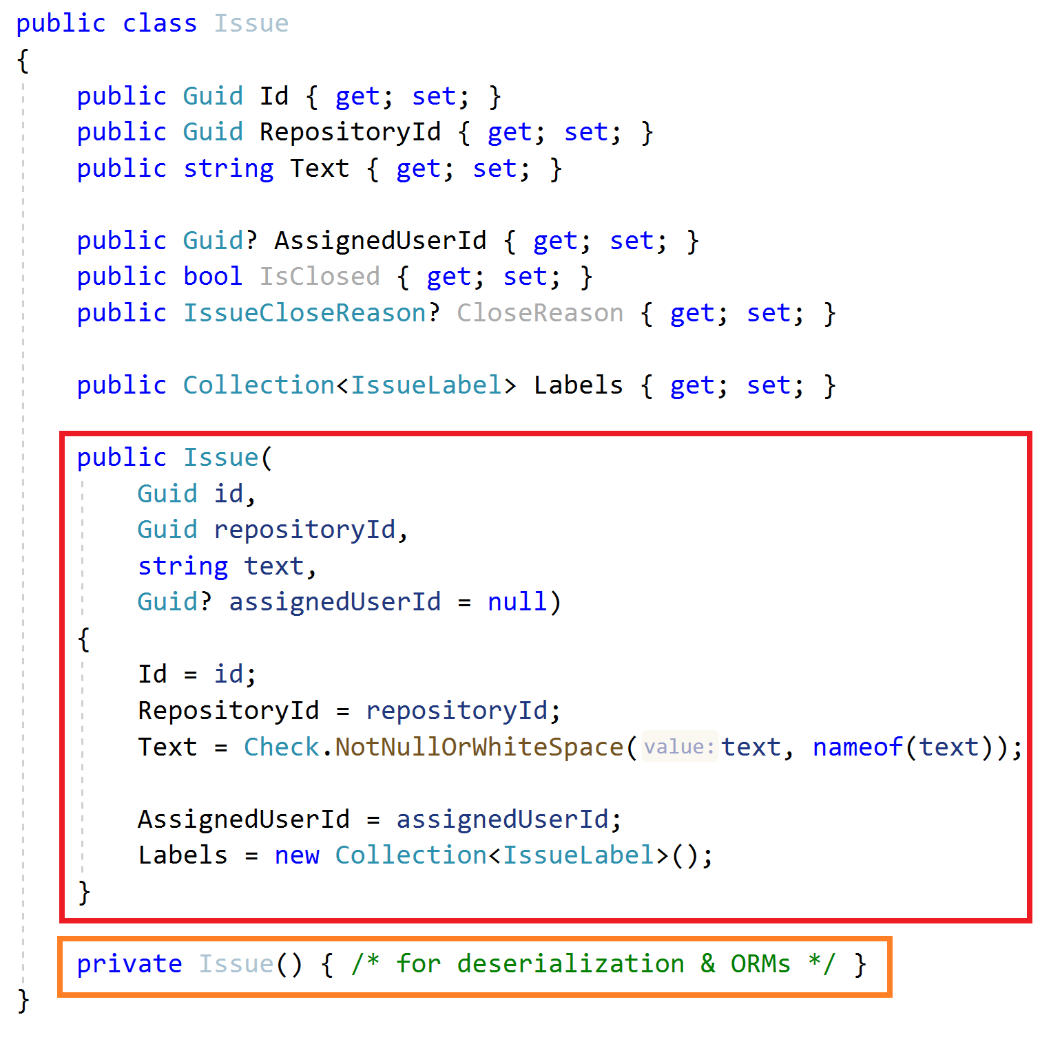
Aggregate Roots / Entities Constructor
Force to create a VALID entity
Get minimum required arguments
Initialize sub collections
Get id as an argument (don’t use Guid.NewGuid())
Use a service to create GUIDs, like IGuidGenerator
Create a private default constructor for ORMs & deserialization

Slide 14
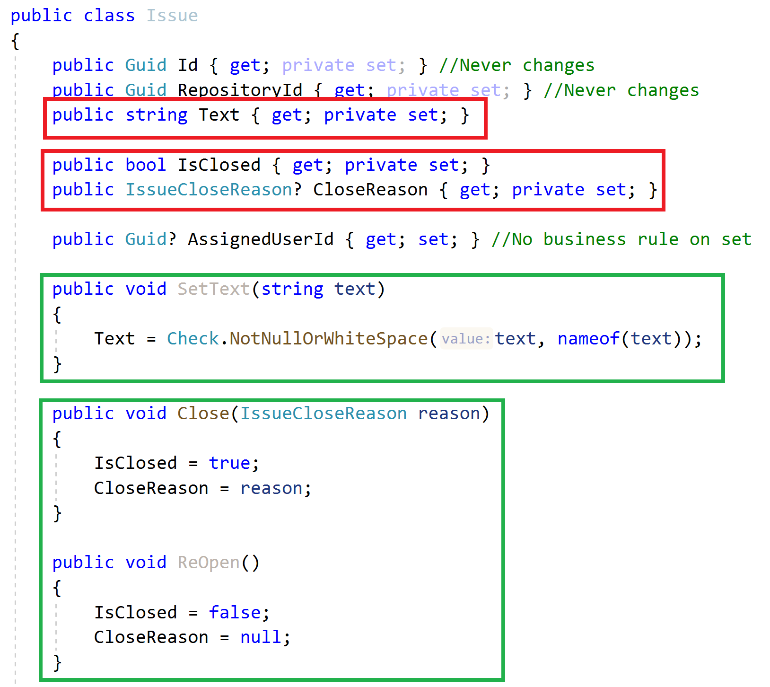
Aggregate Roots / Entities Property Accessors / Methods
Maintain object VALIDITY
Use private setters
Change properties via methods

Slide 15
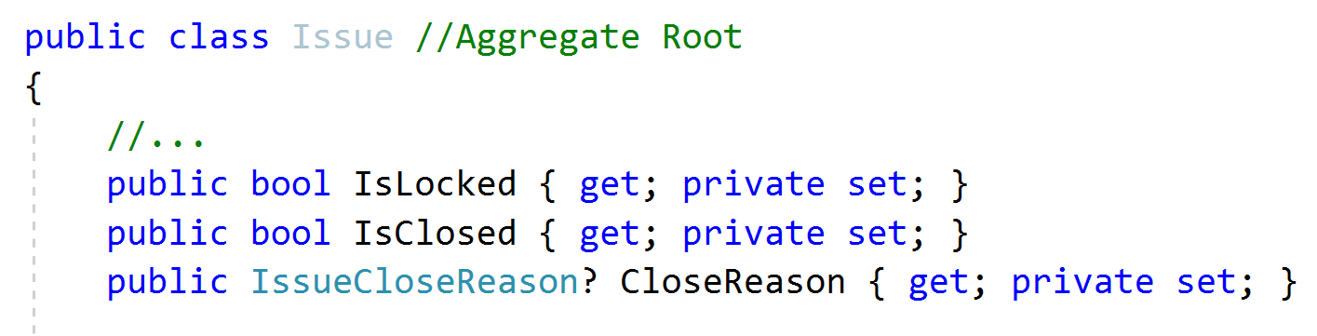
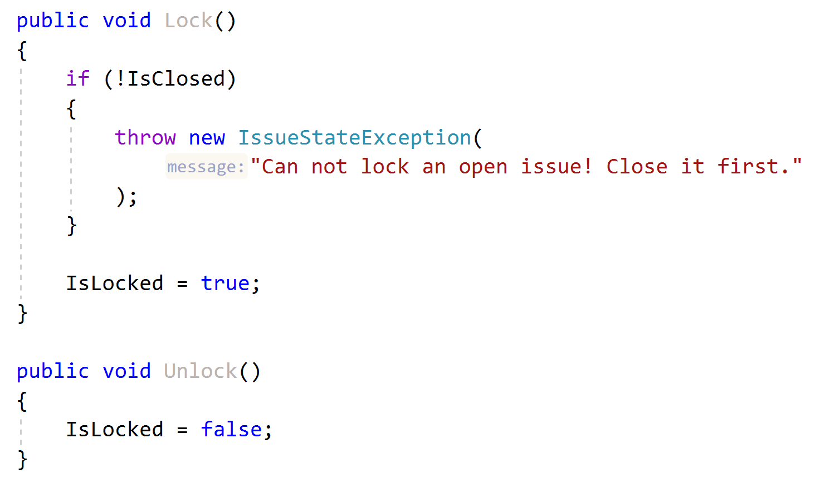
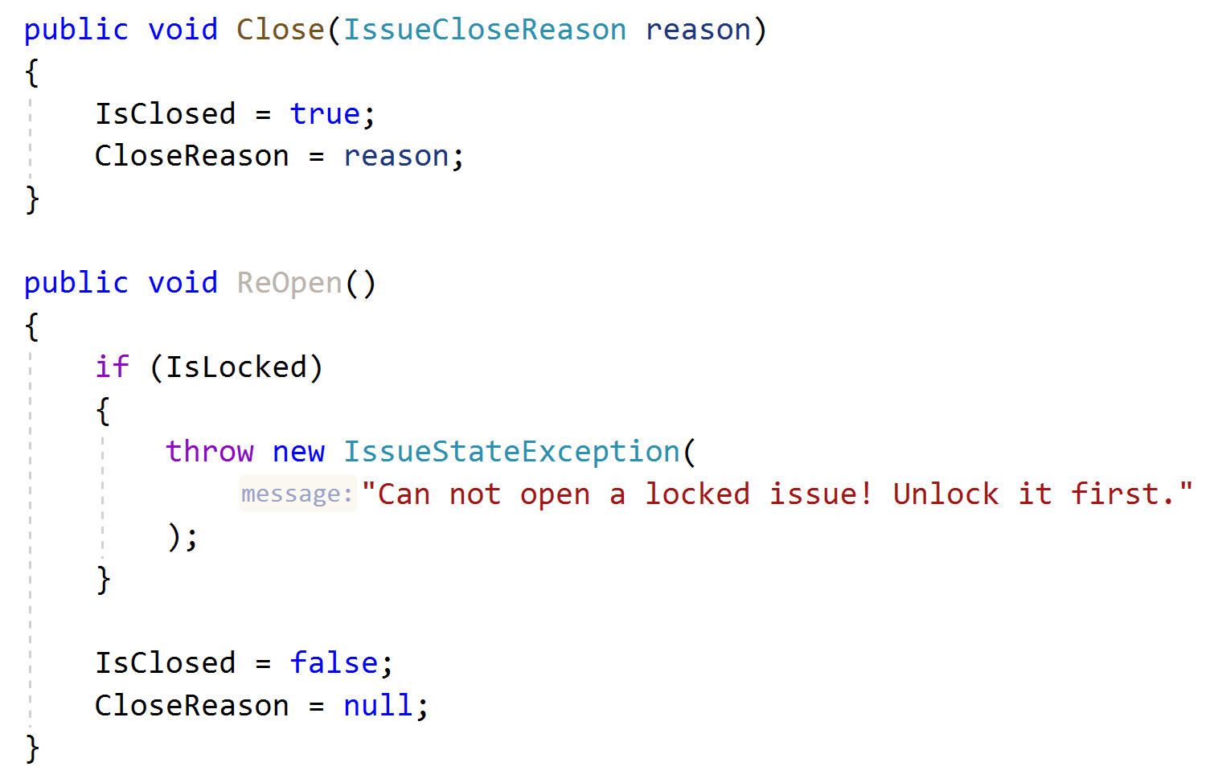
Aggregate Roots / Entities Business Logic & Exceptions
Implement Business Rules
Define a good method name matches to the domain action
Define and throw specialized exceptions

Slide 16
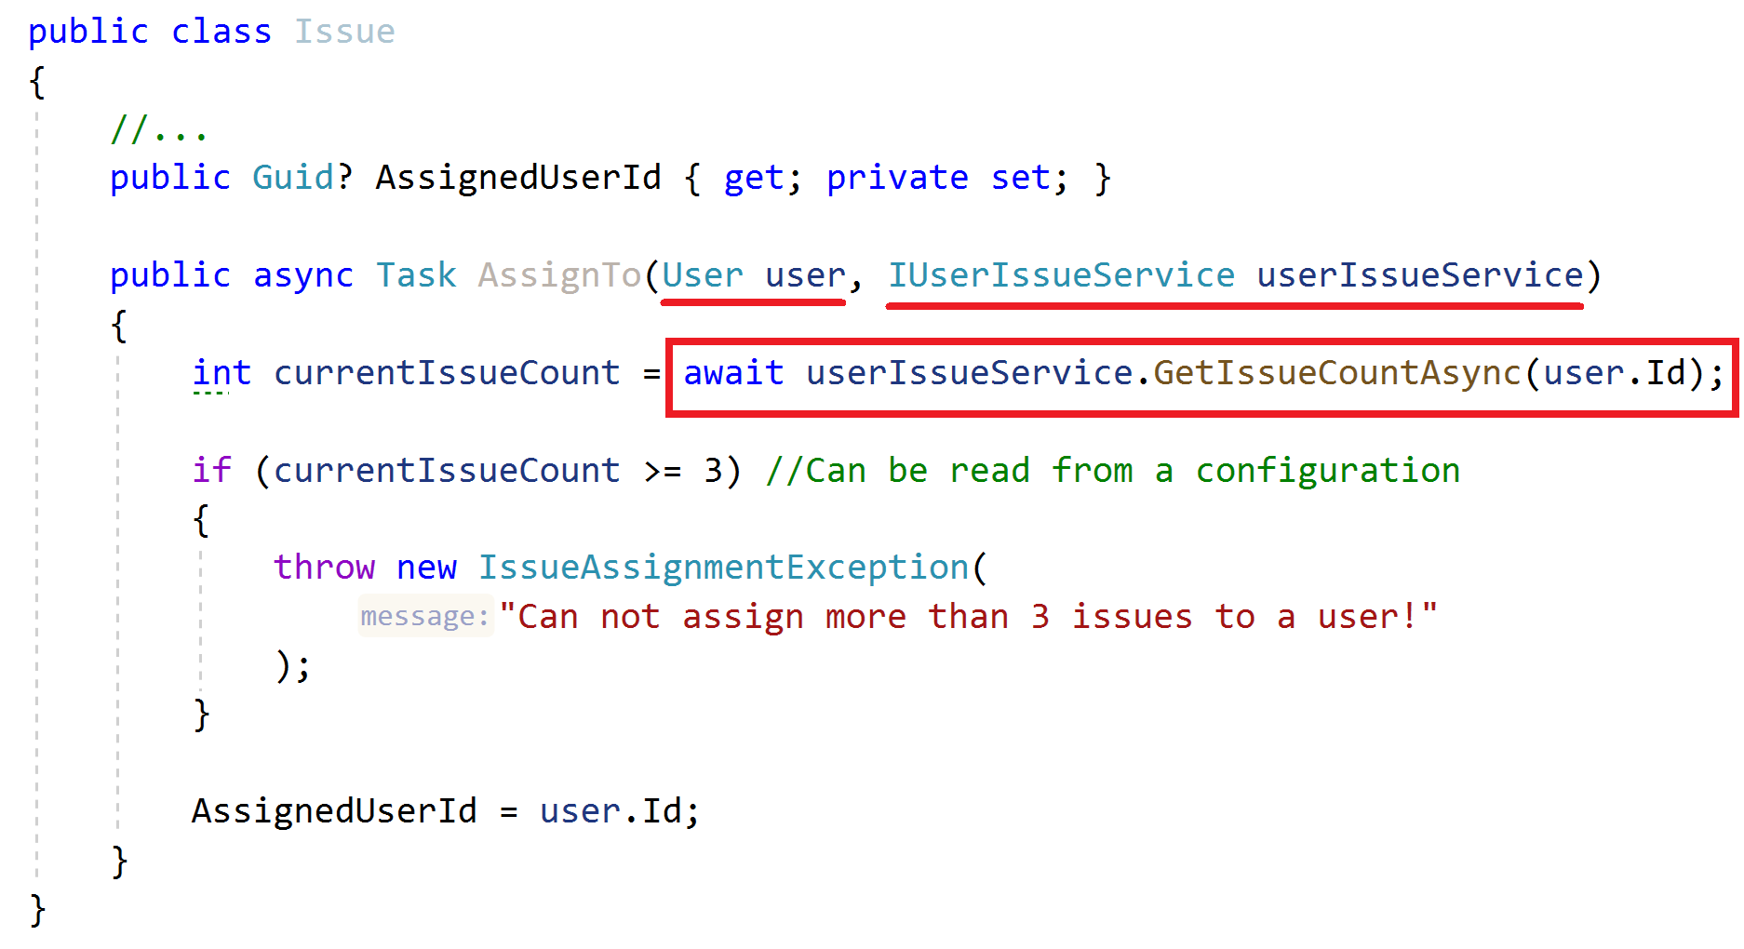
Aggregate Roots / Entities Business Logic
How to implement when you need external services?
Business Rule: Can not assign more than 3 issues to a user!

Slide 17
Aggregate Roots / Entities Business Logic
How to implement when you need external services?
Business Rule: Can not assign more than 3 issues to a user!
ALTERNATIVE..?
Create a Domain Service!

Slide 18
Repositories Principles
Define interface in the domain layer, implement in the infrastructure
Do not include domain logic
Repository interface should be database provider / ORM independent
Create repositories for aggregate roots, not entities

Slide 19
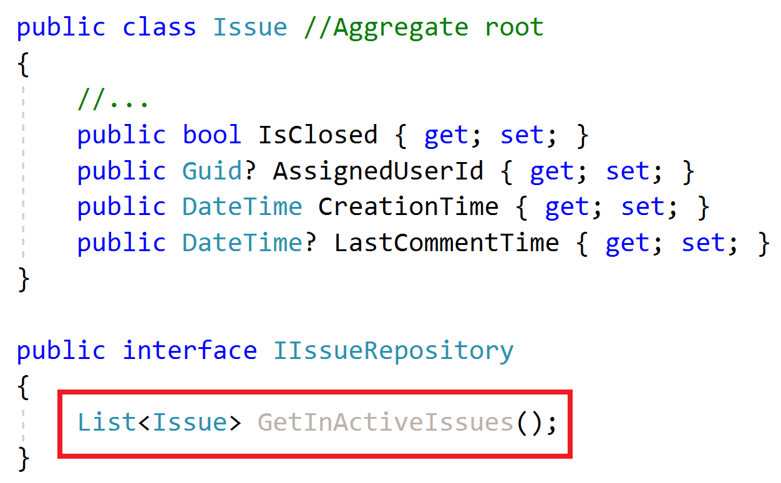
Repositories Do not include domain logic
What is an In-Active issue?

Slide 20
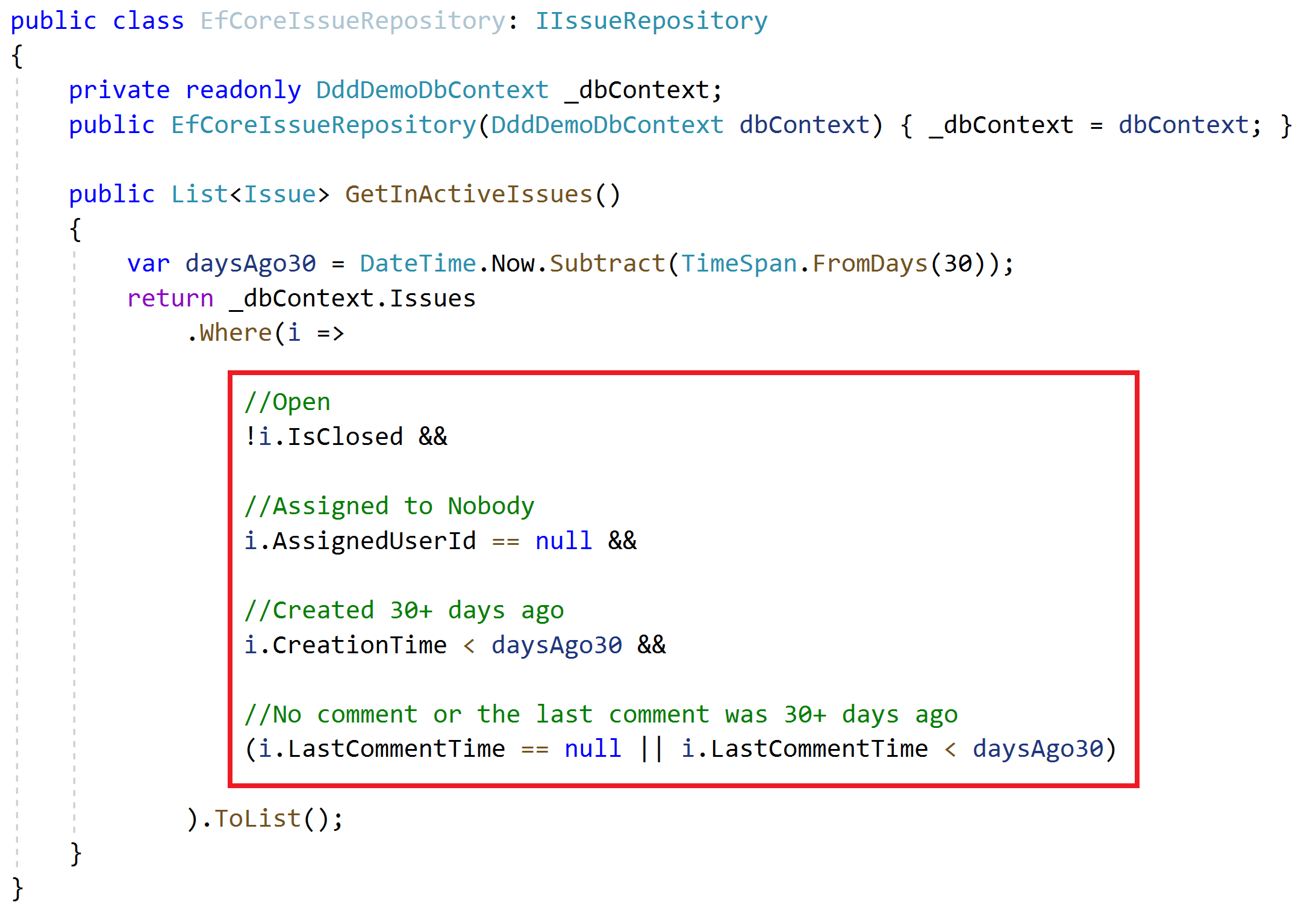
Repositories Do not include domain logic
Implicit definition of a domain rule!
How to re-use this expression? Copy/paste?

Slide 21
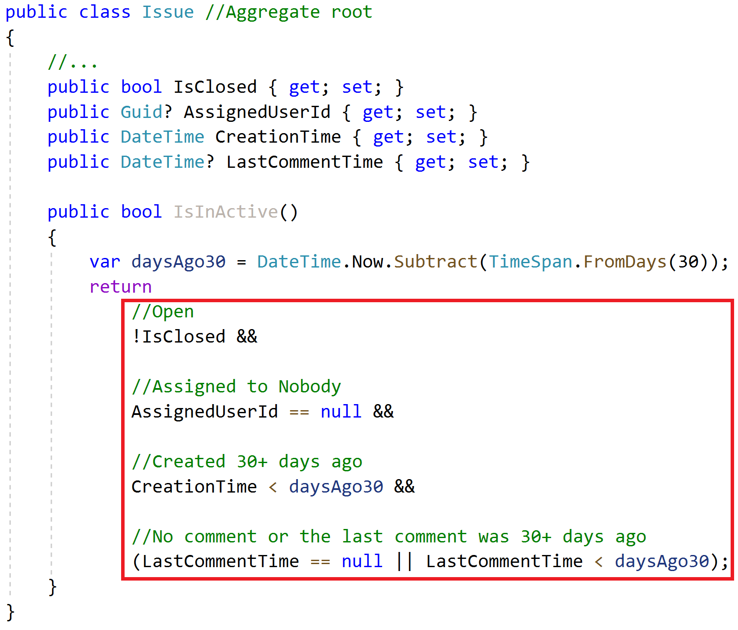
Repositories Do not include domain logic
Implicit definition of a domain rule!
How to re-use this expression? Copy/paste?
Solution: The Specification Pattern!

Slide 22
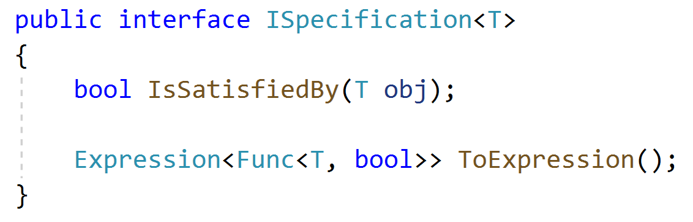
Specifications
A named, reusable & combinable class to filter objects.

Slide 23
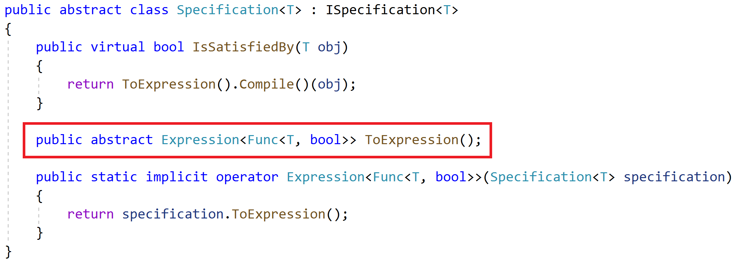
Specifications
A named, reusable & combinable class to filter objects.

Slide 24
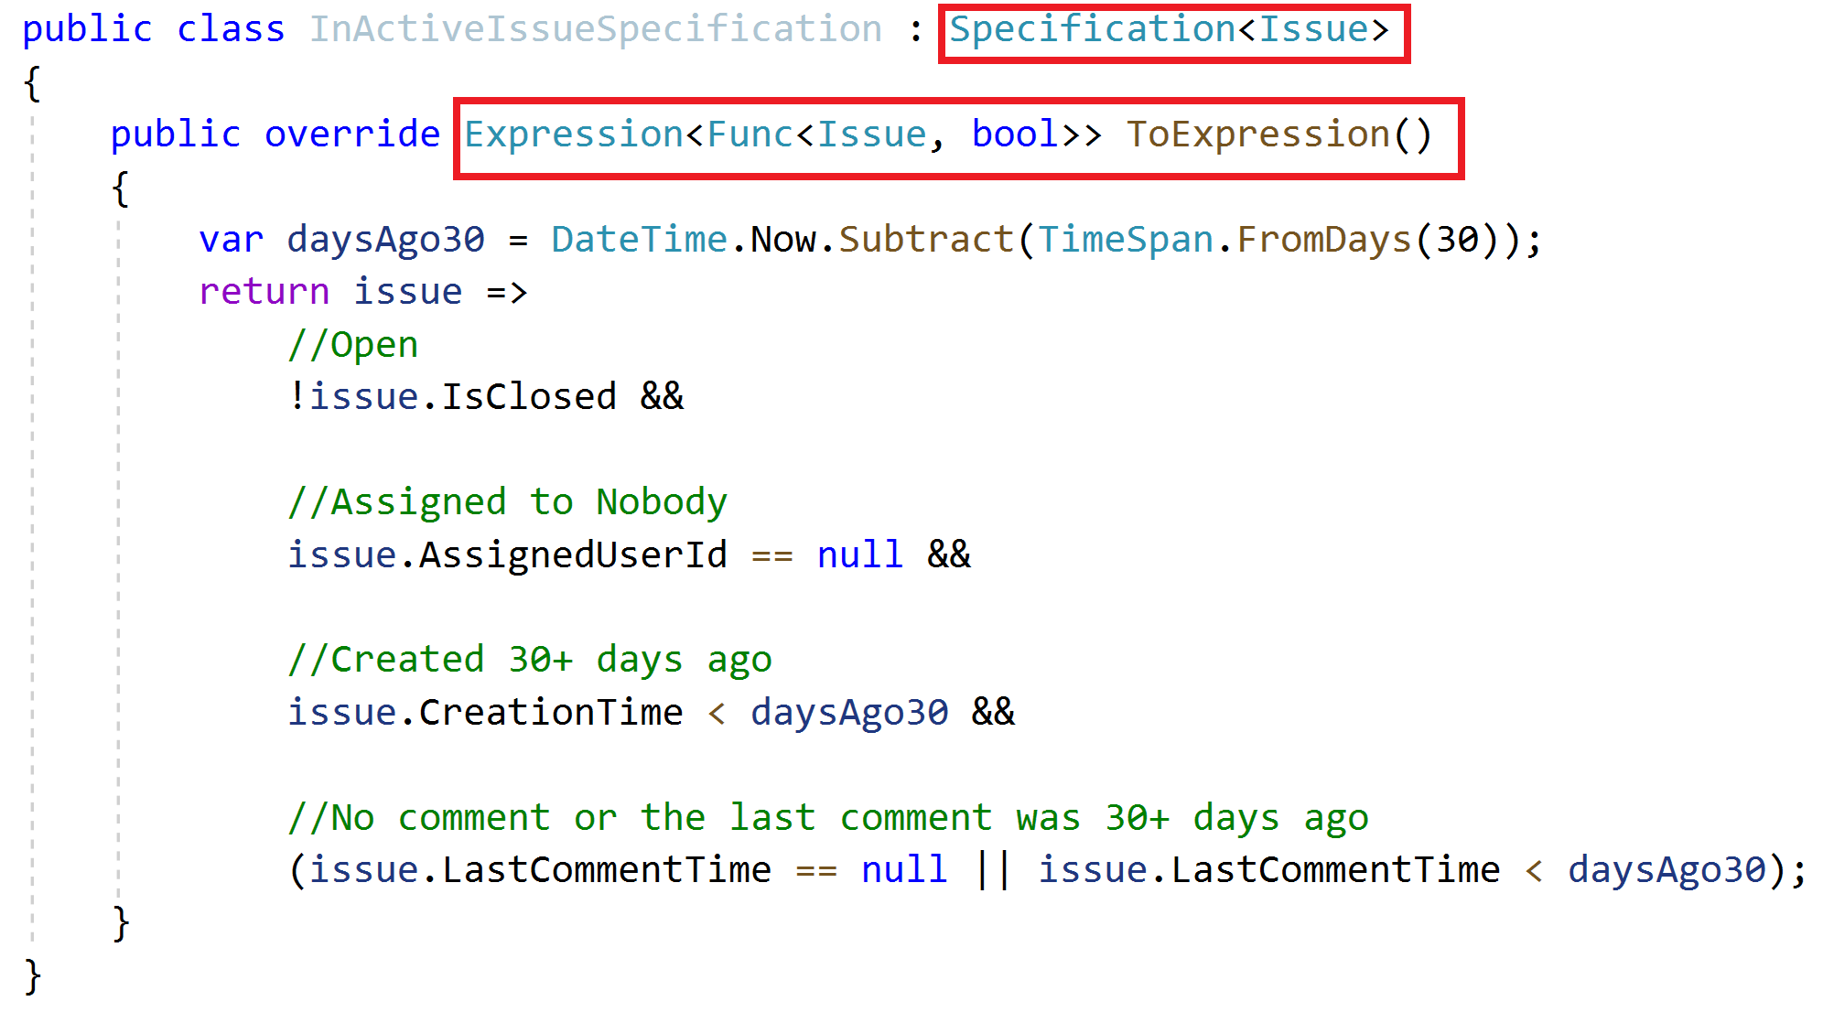
Specifications Define a specification

Slide 25
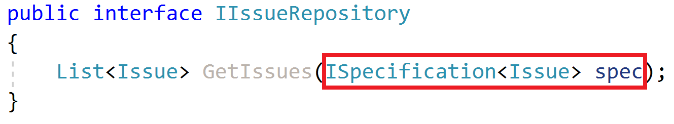
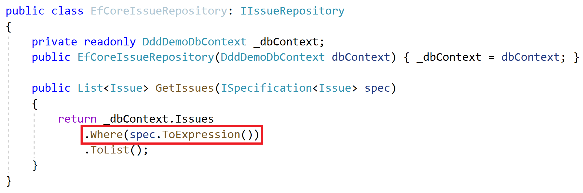
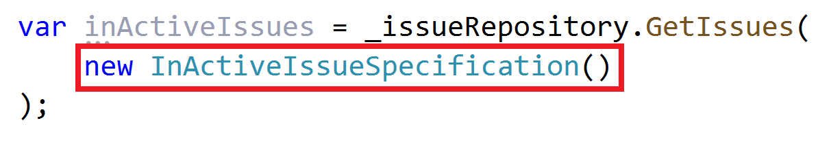
Specifications Use the specification

Slide 26
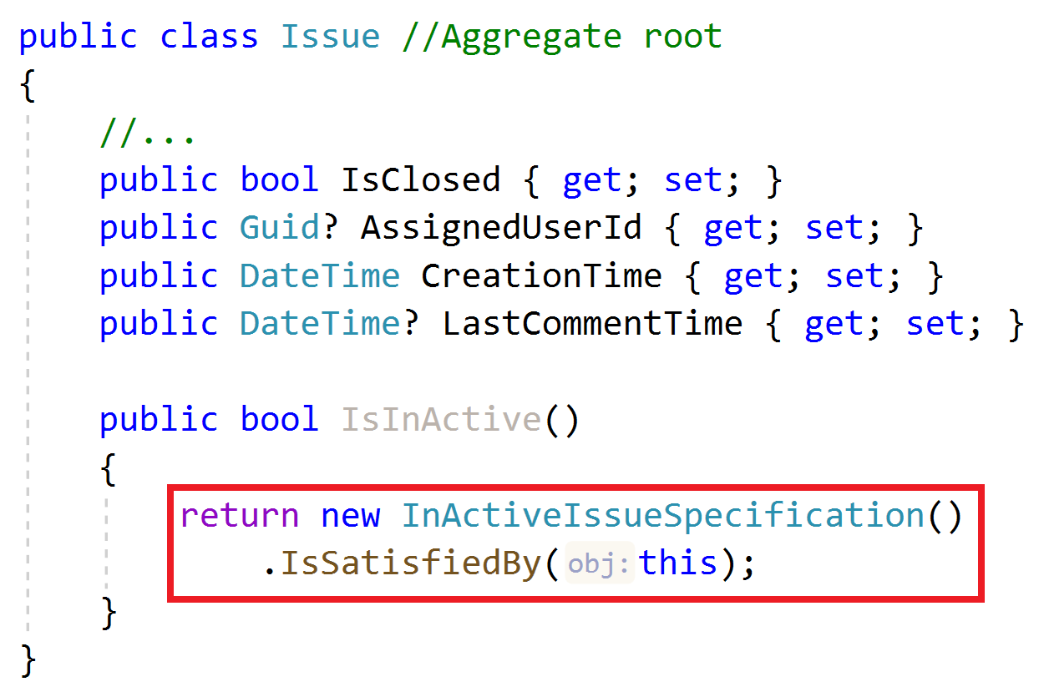
Specifications Use the specification

Slide 27
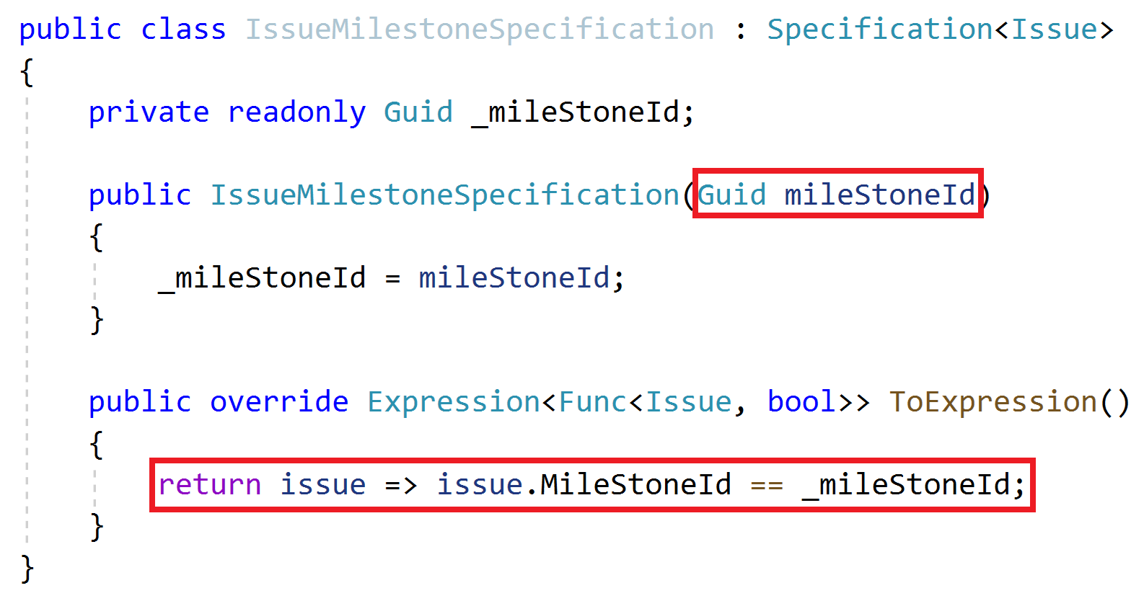
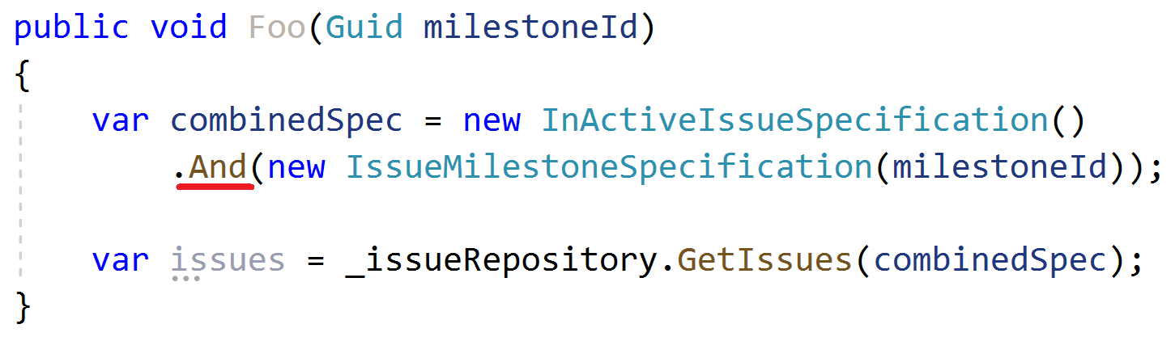
Specifications Combining Specifications

Slide 28
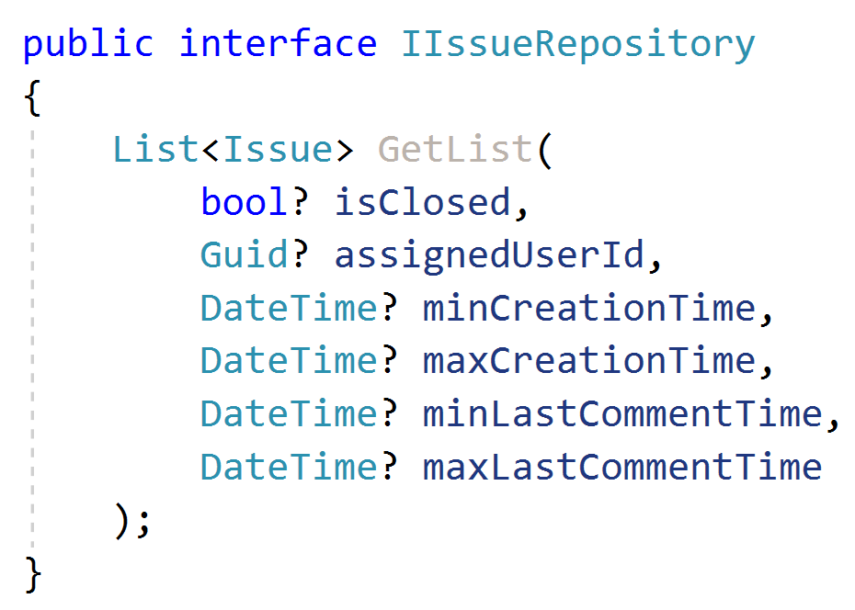
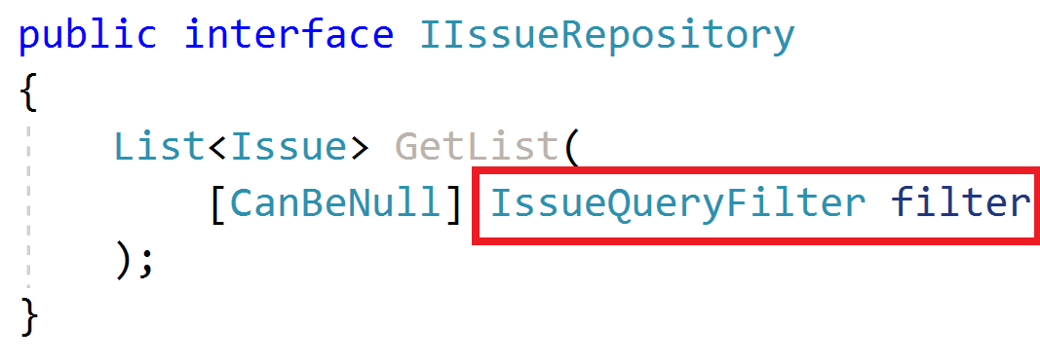
Repositories Querying

Slide 29
Repositories Querying / Read Models
Read model: A special entity-like class to read data from the database.
Minimize read models, do not use for single-entity operations
Define & use read models only in performance critical parts
TODO: Example
Do not reuse aggregate roots or entities inside read models
TODO: Example (UserWithRole, SimpleUser, DetailedUser… etc.)

Slide 30
Repositories Querying / Read Models
TODO…

Slide 31
Domain Services Principles
Implements domain logic;
Depends on services/repositories
Needs to work with multiple entities / entity types
Create for aggregate roots, not for entities
Work with domain objects, not DTOs

Slide 32
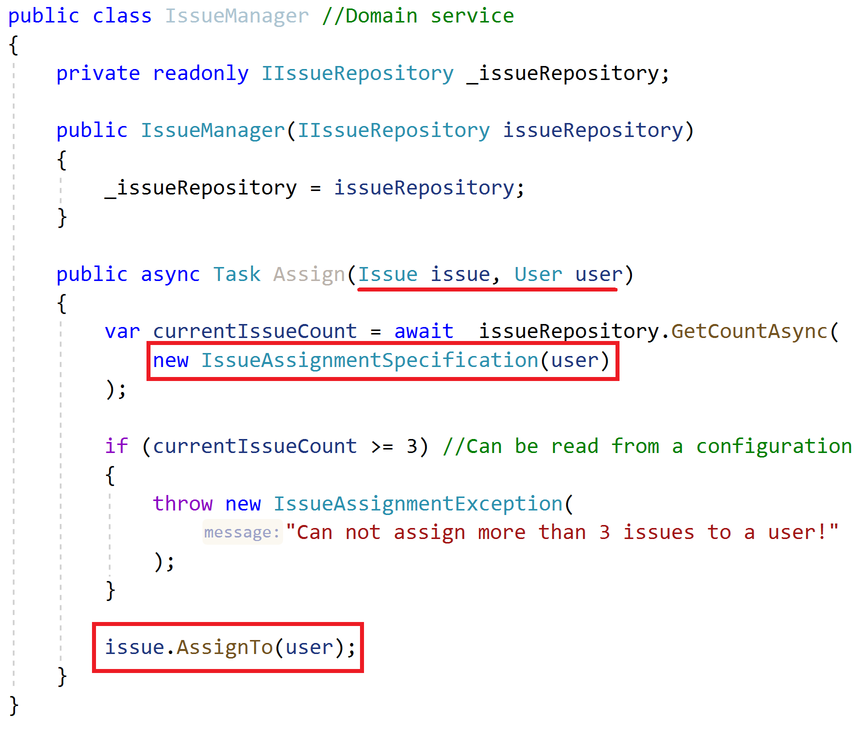
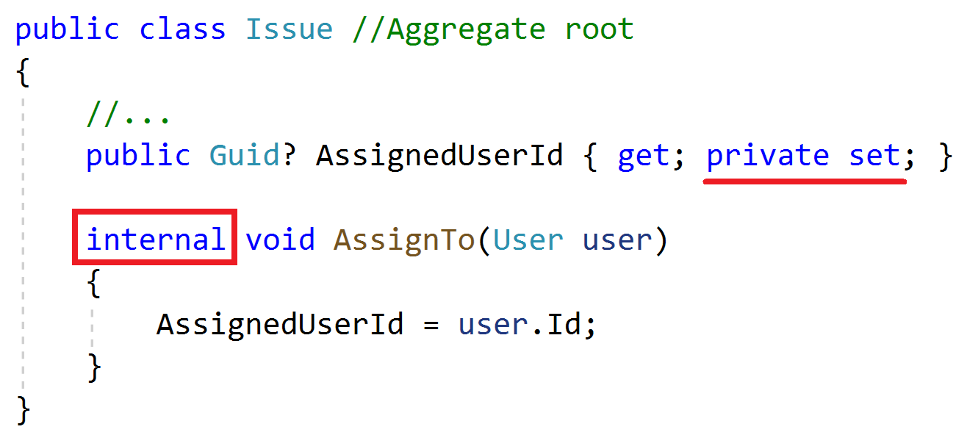
Domain Services Example

Slide 33
Domain Services More…
TODO

Slide 34
Application Services Principles
Implement use cases of the application (application logic), not domain logic!
Get & return Data Transfer Objects, not entities!
Use entities, repositories and other domain objects inside

Slide 35
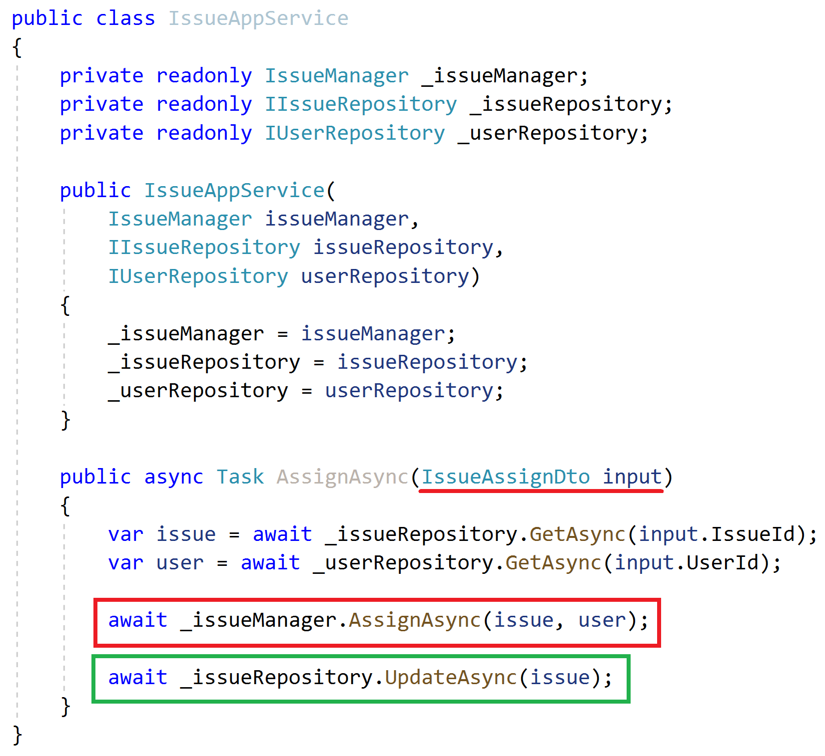
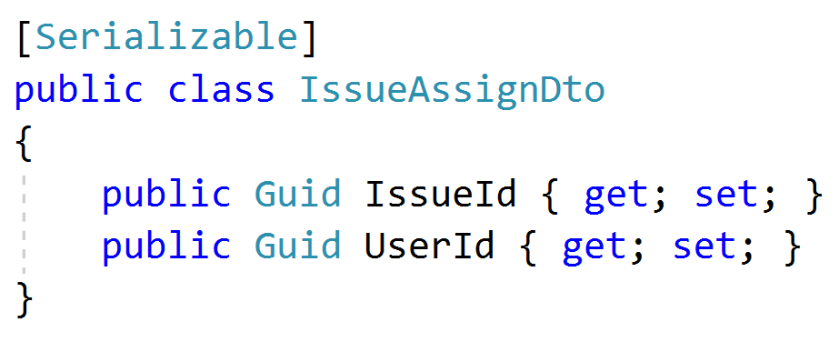
Application Services Example
Inject domain services & repositories
Get DTO as argument
Get aggregate roots from repositories
Use domain service to perform the domain logic
Always update the entity explicitly (don’t assume the change tracking)

Slide 36
Application Services Common DTO best practices
Should be serializable
Should have a parameterless public constructor (implicit/explicit)
Should not contain any business logic
Never inherit from entities! Never reference to entities!

Slide 37
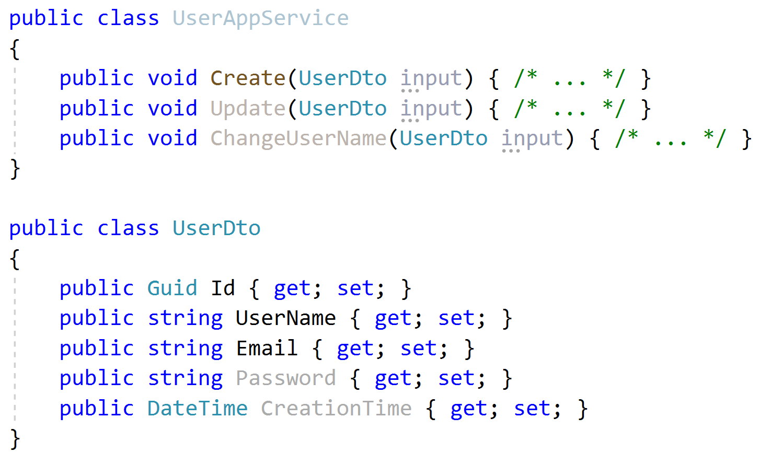
Application Services Input DTO best practices
Define only the properties needed for the use case
Do not reuse same input DTO for multiple use cases (service methods)
Id is not used in create! Do not share same DTO for create & update!
Password is not used in Update and ChangeUserName!
CreationTime should not sent by the client!

Slide 38
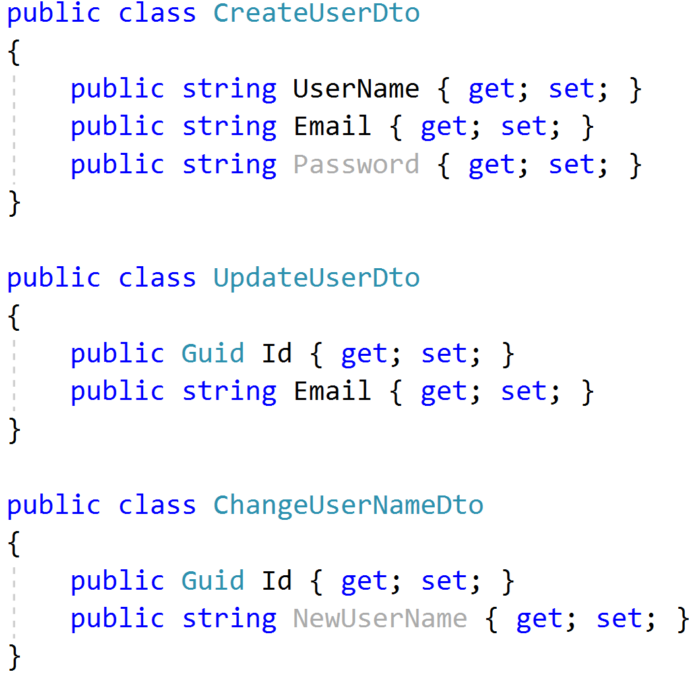
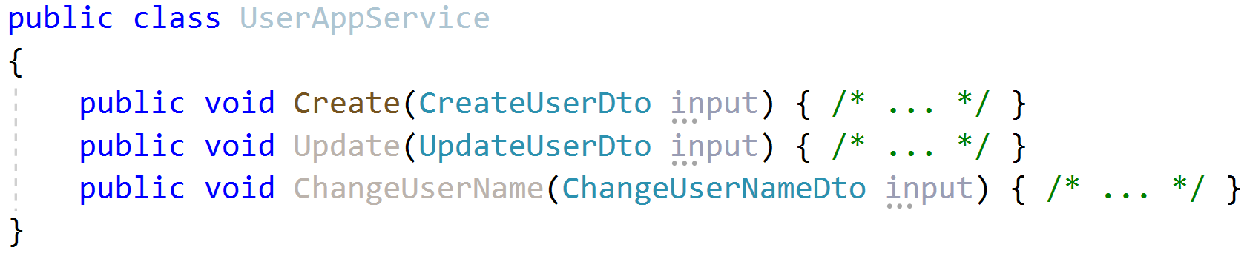
Application Services Input DTO best practices
Define only the properties needed for the use case
Do not reuse same input DTO for multiple use cases (service methods)

Slide 39
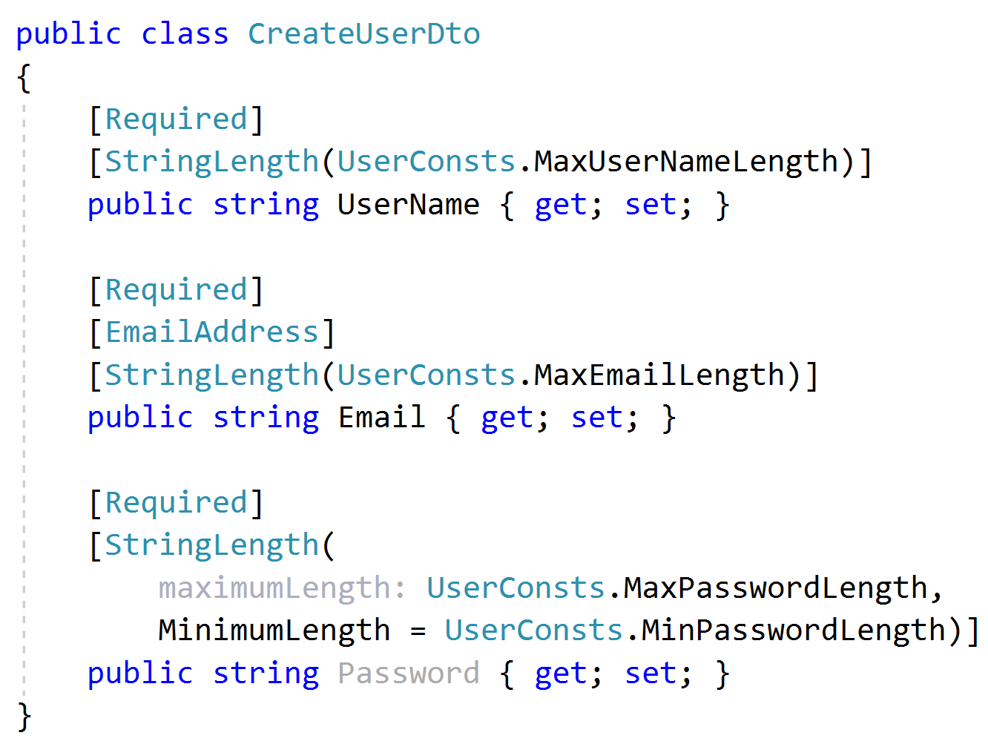
Application Services Input DTO best practices
Implement only the formal validation (can use data annotation attributes)
Don’t include domain validation logic (ex: unique user name constraint)

Slide 40
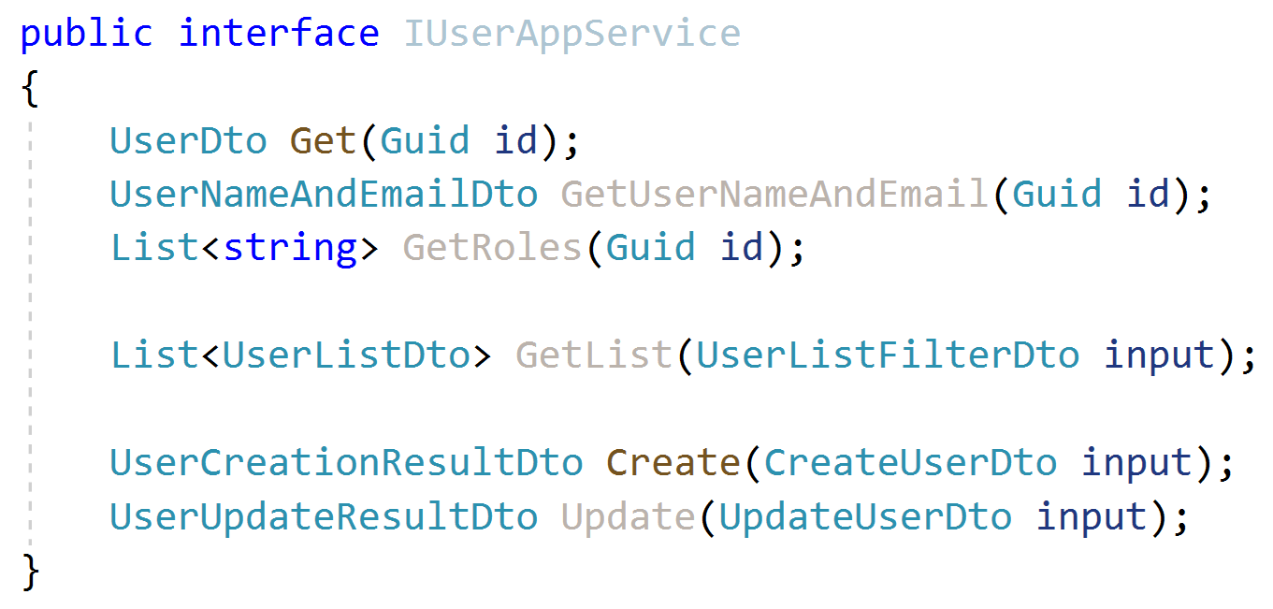
Application Services Output DTO suggestions
Keep output DTO count minimum. Reuse where possible (except input DTOs as output DTO).
Return the entity DTO from Create & update methods.
Can contain more data than client needs
Exception: Where performance is critical, especially for large result sets.

Slide 41
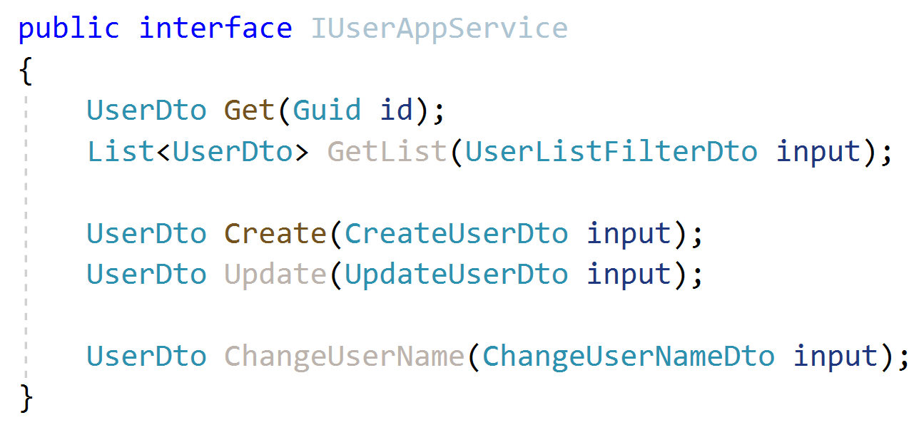
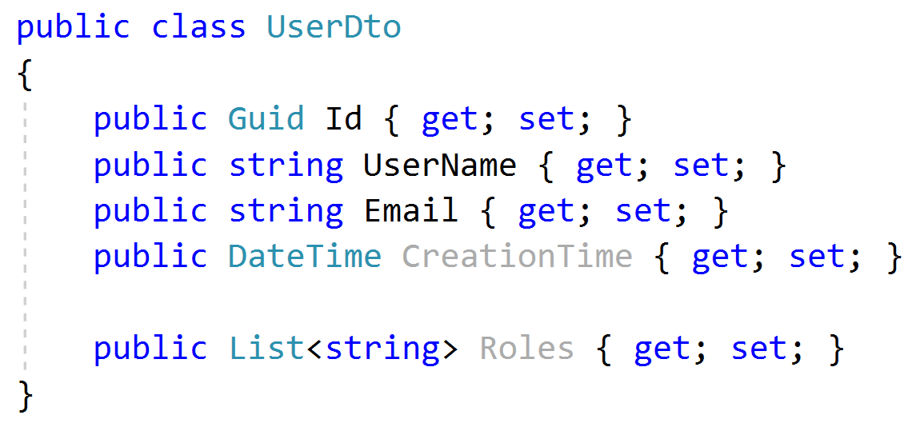
Application Services Output DTO suggestions
Keep output DTO count minimum. Reuse where possible (except input DTOs as output DTO).
Return the entity DTO from Create & update methods.
Can contain more data than client needs
Exception: Where performance is critical, especially for large result sets.

Slide 42
Application Services Object to Object Mapping
Use auto object mapping libraries (but, carefully – enable configuration validation)
Do not map input DTOs to entities. Map entities to output DTOs

Slide 43
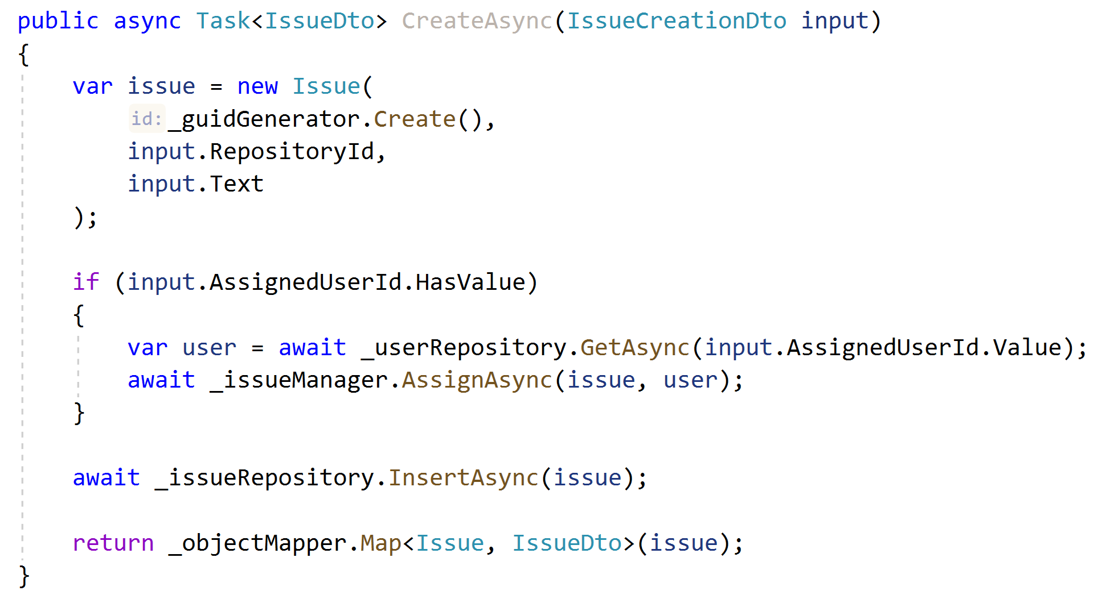
Application Services Example: Entity Creation
Don’t use DTO to entity auto-mapping, use entity constructor.
Perform additional domain actions.
Use repository.
Return DTO using auto-mapping.

Slide 44
Domain/Business Exceptions
Do not return null or operation result code for exceptional cases, throw exceptions!
Define exception classes for important business rules
Include an error code in the exception
Separate localization from exception throwing
Map exceptions to HTTP status codes

Slide 45
Domain/Business Exceptions

